Slide 1
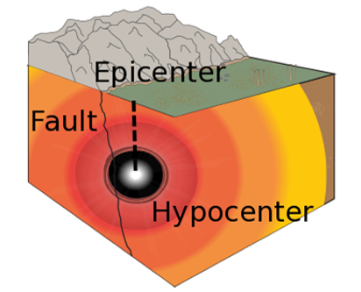
Physics-Informed Source Localization via RL-driven Adaptive Sampling PINNs
Lucas Zheng, Yash Kothari, Kevin Pan, Fillip Cutiuba

Slide 2
Table of contents
01
02
03
04
Background & Motivation
Dataset & Problem Setup
RL + Adaptive Sampling
PINNs

Slide 3
01
Background & Motivation

Slide 4
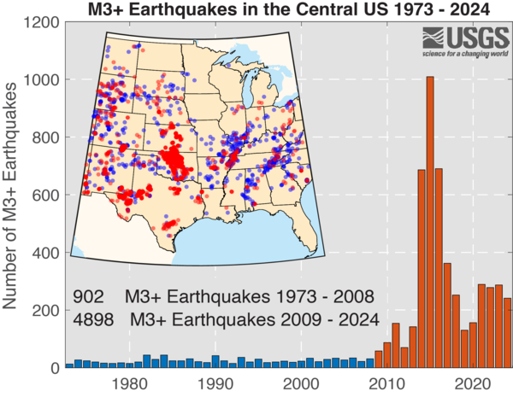
Background
Significant rise in induced earthquakes across U.S. since 2009
Correlates with a rise in fluid injection, fracking, or geothermal operations
Smaller seismic events (< M4 earthquakes) still pose significant regulatory and operational risks
Determining source location of microseismic activity is critical for safety
  Used to prevent nearby induced activity
  Early detection of stronger seismic activity
Physics-Informed Neural Networks (PINNs) offer a solution to solving the source localization problem

Slide 5
02
Dataset &
Problem Setup

Slide 6
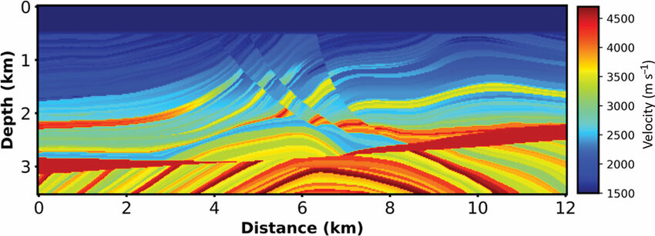
Dataset & Problem Setup
Marmousi2 velocity model: synthetic 2D map of seismic velocities simulating complex geology, designed by geophysicists
We downsample (by taking every 20th grid coord) to form a 2D subsurface domain with spatially varying wave speed
Roughly 38 mil grid points to 96k from downsampling

Slide 7
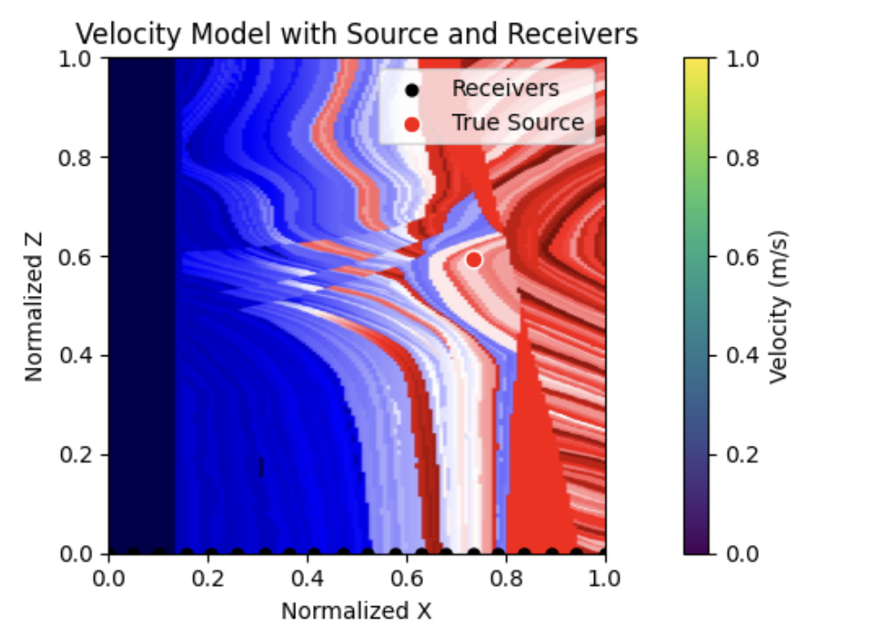
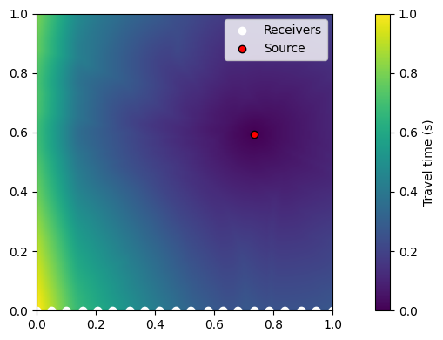
Dataset & Problem Setup
True source location is randomly selected within domain
20 receivers are placed uniformly along the surface (z=0), ground truth travel times are calculated using numerical methods of solving the Eikonal equation (to simulate actual receivers)
Typically, Eikonal eq. solvers are given the velocity map and source to solve the traveltime field, here we solve (a harder version) of the inverse problem - given velocity map and surface receiver picks (parts of traveltime field), determine the source
Objective: Recover the source locale using only travel times at receivers and the underlying velocity map

Slide 8
03
PINN

Slide 9
PINN Formation
Objectives:
Estimate unknown source location (x_{s}, z_{s}) from surface receiver picks and velocity map
Predict travel time field τ (x, z) by solving the Eikonal equation with a neural network
Eikonal equation: | ⛛τ (x, z)| ² = s(x, z) ²
  τ(x,z) = traveltime from a source to point 𝑥
  v(x,z) = wave velocity at position (𝑥,z)
  s(x,z) = 1 / v(x,z) = slowness
Let τ (x, z) solve
| ⛛τ (x, z)| ² = s(x, z)² (Eikonal eq.)
τ (x_{s}, z_{s}) = 0 (boundary condition: travel time at source should be 0)
s(x, z) = 1 / v(x,z)
where
v(x,z) : velocity map of waves from downsampled Marmousi2 velocity model

Slide 10
PINN Architecture
Model Architecture:
Fourier Feature Encoding (256 mapping size, scale = 10.0)
Transforms 2D spatial inputs (x, z) into 512-dimensional high-frequency space using sinusoidal projections
Helps PINN learn high-frequency spatial variations in the velocity model, in order to model fine-scale wavefront behavior
MLP
3 hidden layers, 256 neurons per, Tanh activations
Inputs: Normalized spatial coordinates (x, z)
Outputs: Predicted traveltime τ^ (x, z)
Input Coordinates
(x , z)
FF Encoding (2D → 512D)
(sin(2𝛑Bx), cos(2𝛑Bx))
MLP
(512 → 256, tanh)
(256 → 256, tanh)
(256 → 256, tanh)
(256 → 1)
Predicted time field
τ^ (x, z)

Slide 11
Loss Components
Loss Components
PDE Loss (enforces physics w/ Eikonal eq.) :
⛛τ (x, z)| ² - s(x, z) ² → 0
Data Loss (matches predicted traveltimes to observed picks from receivers):
τ^ (x_{i} , z_{i} ) ≈ t_{i}(obs)
Source Loss (boundary condition: enforces predicted traveltime at source location to be 0):
τ^ (x_{s} , z_{s}) = 0
L = w_{pde}L_{pde} + w_{data}L_{data} + w_{src}L_{src}
where w_{pde}, w_{data} are learnable loss weights to let the model figure out how strongly to enforce PDE and data conditions
Also apply weight schedule on w_{src}, starts lower then increases

Slide 12
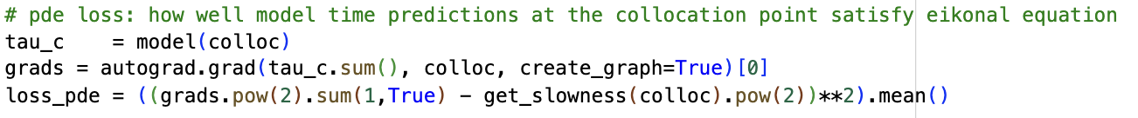
Loss Components
(1)
(2)
(3)

Slide 13
03
RL + Adaptive Residual Sampling

Slide 14
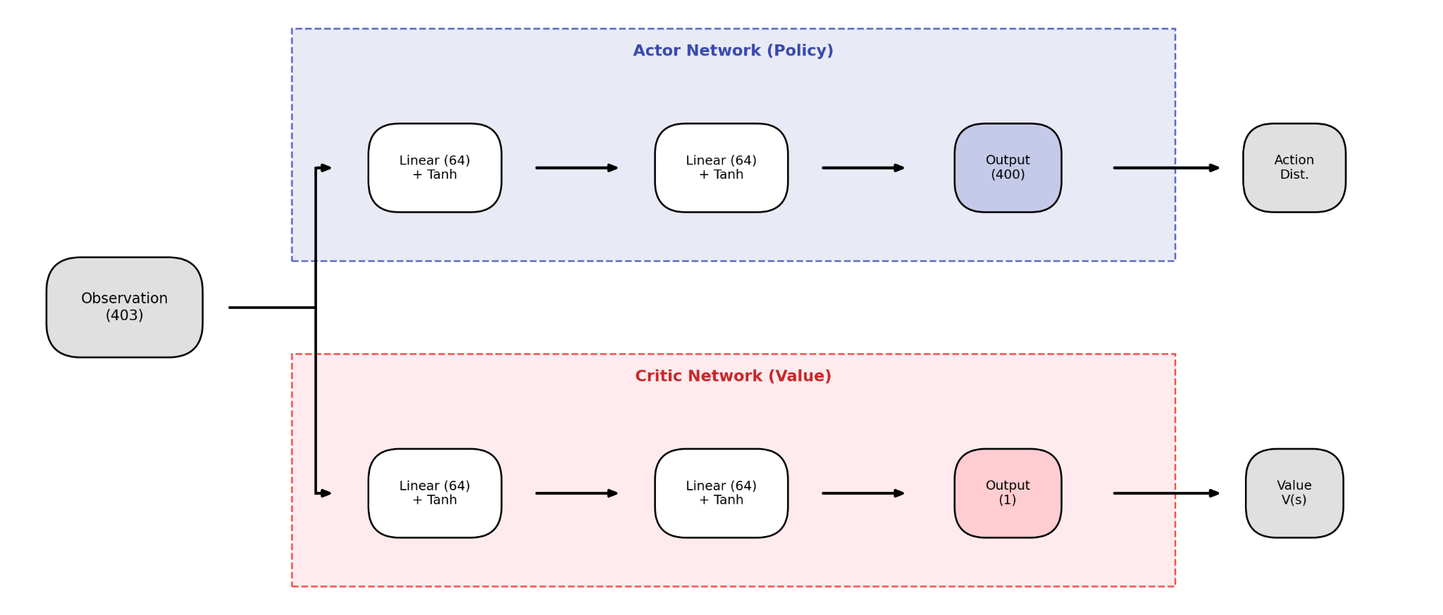
RL
Standard Heuristics are Limited
Random ⇒ Wasted Computation on “easy” areas
Residual Sampling ⇒Resamples noisy gradients & singularities inhibiting global convergence
Goal: Replacing rules with policy for faster long-term convergence

Slide 15
Residual Sampling vs. RL Sampling
Adaptive Residual Sampling
Instead of always randomly sampling points to train, every 100 epochs we choose collocation points based on where PINN violates physics the most
Turn point-wise PDE residuals into a probability distribution, sample from this distribution to get training points
RL Sampling w/ PPO
Framing: Collocation Point Selection as seq. decision making problem
State: PDE Residuals at fixed candidates + current loss values
Action: Selection out of 400 grids (20x20) to add to collocation set
Reward: Loss reduction across steps - localization_error

Slide 16
04
Results &
Conclusion

Slide 17
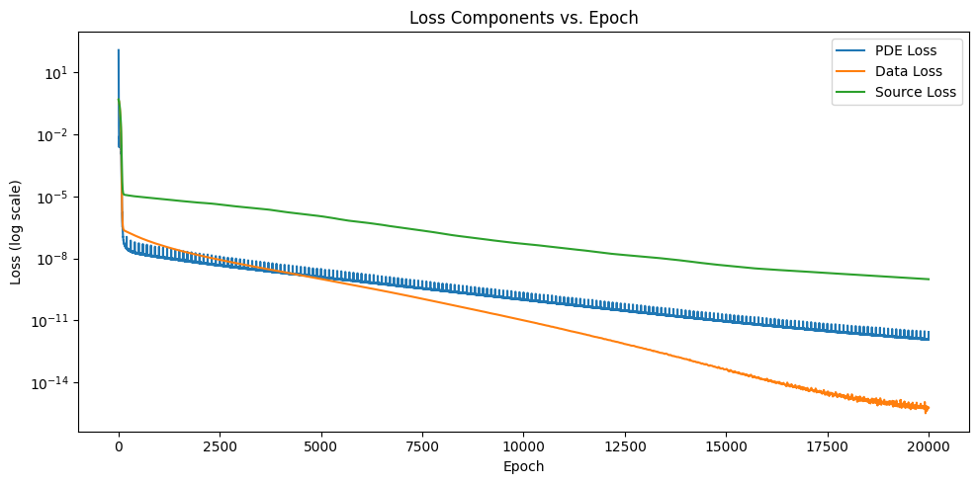
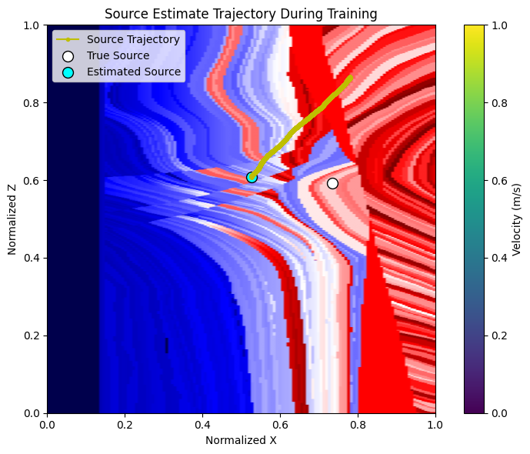
PINN + Adaptive Sampling
Spikes from adaptive sampling when sampler samples from training points where physics is violated the most
Issue we observe is that with this velocity map, predicted source almost always travels “down and to the left”

Slide 18
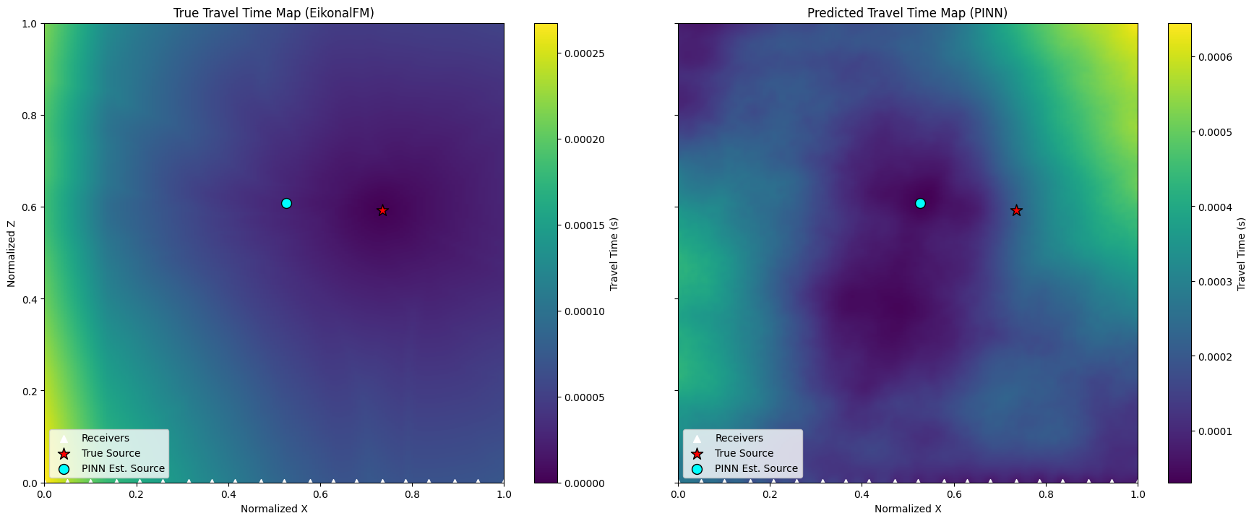
PINN + Adaptive Residual Sampling

Slide 19
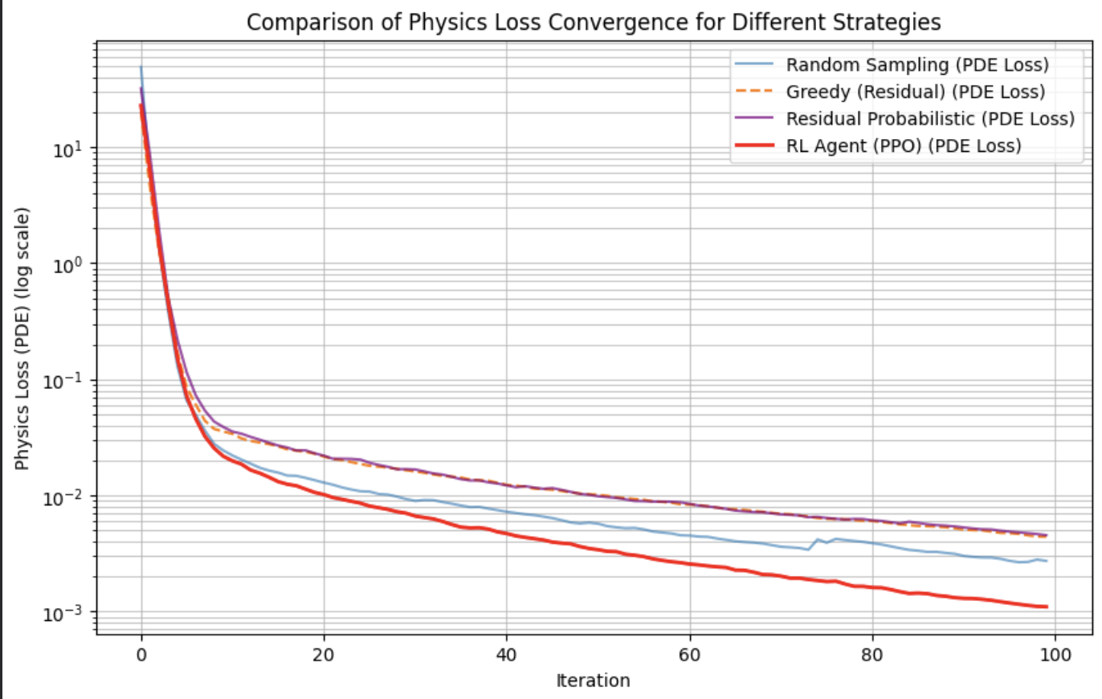
RL Loss Convergence Comparison

Slide 20
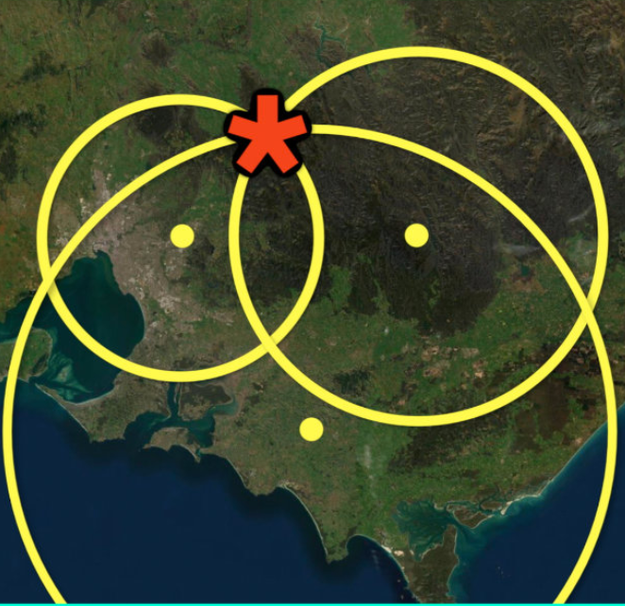
Conclusion / Reflection
The Core Challenge: The "Coupled" Optimization Problem.
  Standard Methods: Numerical Eikonal equation solvers require a fixed, true source to mathematically define the travel-time field (Source ⇒ Field)
  Our Bottleneck: Our task attempted to solve for both traveltime field and true source simultaneously with only receiver data
  Result: This removed the necessary "anchor" for the physics. Because the PINN had to learn the field and the source at the same time, it faced an unstable "moving target" rather than a clear optimization path
Next steps:
  Adopt a more traditional approach, optimize the predicted source while relying on eikonal fm approach to calculate traveltime field rather than learning it

